Slide 1



Fun Fact Generator web App
PROJECT MEMBERS
JEEVASHRE.G : 23ITR071
NANDHINI.E : 23ITR108
JEENAS DEEPA : 23ITR070
JAIHARI D (19ITR028)

Slide 2

The goal is to develop a highly engaging Fun Fact Generator web application that delivers random, interesting facts to users at the click of a button.
✓ Users can explore facts through various categories such as Science, History, and Technology, and apply filters for a more personalized experience.
✓ This web app will include advanced filtering options, enabling users to tailor their fact feed according to their preferences or specific themes.

Slide 3
Objectives
To create an interactive fun facts to users, enhancing their
knowledge in a fun and engaging way.
To provide a simple user-friendly platform for quick
entertainment and learning.
Fun facts can be used to educate users in a light-hearted manner,
making learning more enjoyable and memorable.
3

Slide 4



Software / Hardware Tools used
Backend Tools:
Python : Used for backend development
Flask : Web Framework
MySQL : Database Management
Fronted Tools:
HTML : It provides a structure content
CSS : It is used to style and layout HTML elements
JAVASCRIPT : Dynamic and enabling real time user interactions.
4

Slide 5
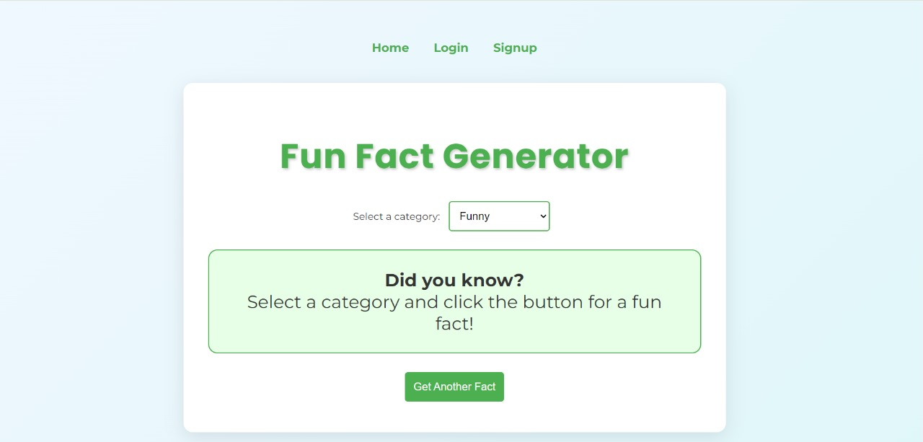
MODULE 1: FUN FACT GENERATOR IMPLEMENTATION

Slide 6
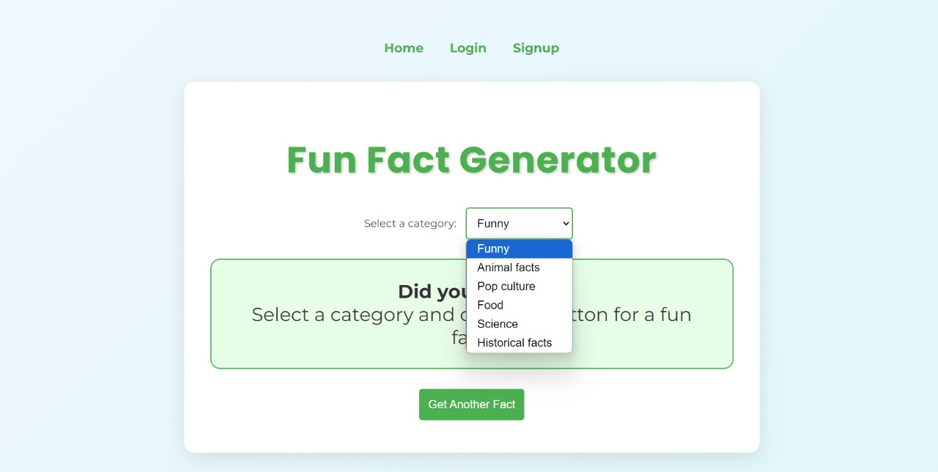

Slide 7
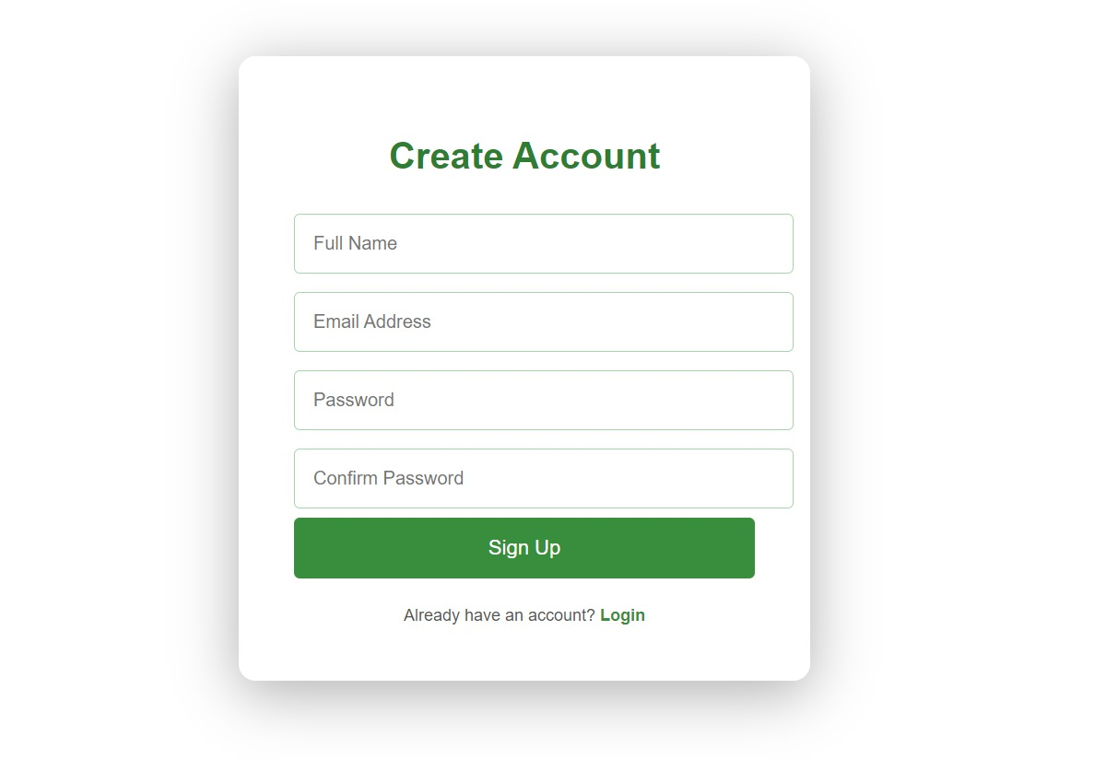
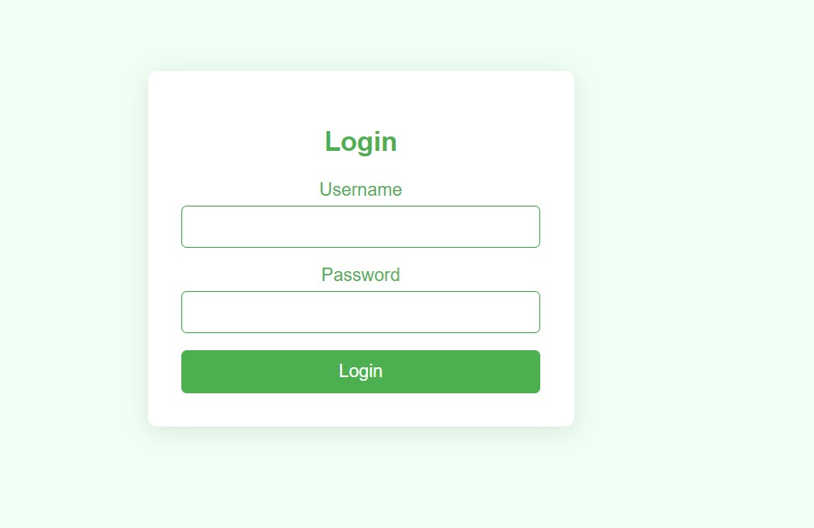
MODULE 2: LOGIN AND SIGN UP PAGE

Slide 8
Reference
https://www.geeksforgeeks.org/fun-fact-generator-web-app-in-python/
https://github.com/someuser/fun-fact-generator
https://www.tutorialspoint.com/fun-fact-generator-web-app-in-python
https://pypi.org/project/randfacts/

Slide 9
Thank you

